Slide 1
2012 Strategic Plan to Increase Funds
Rachael Solomon
Unique
Notes:
Welcome, today we will be discussing ideas and options to increase funds raised for the International Service Abroad club. We will look at the increasing need to explore new areas for fundraising efforts and new ideas for current fundraising activities. <click>
References
International Service Abroad (2012). Logo [digital image]. Retrieved August 30, 2012 from J. Bagley, personal communication [email].

Slide 2
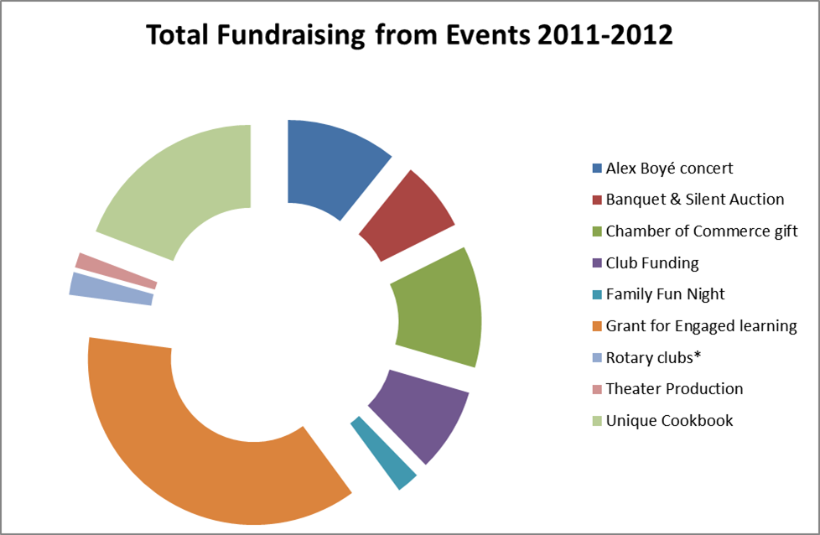
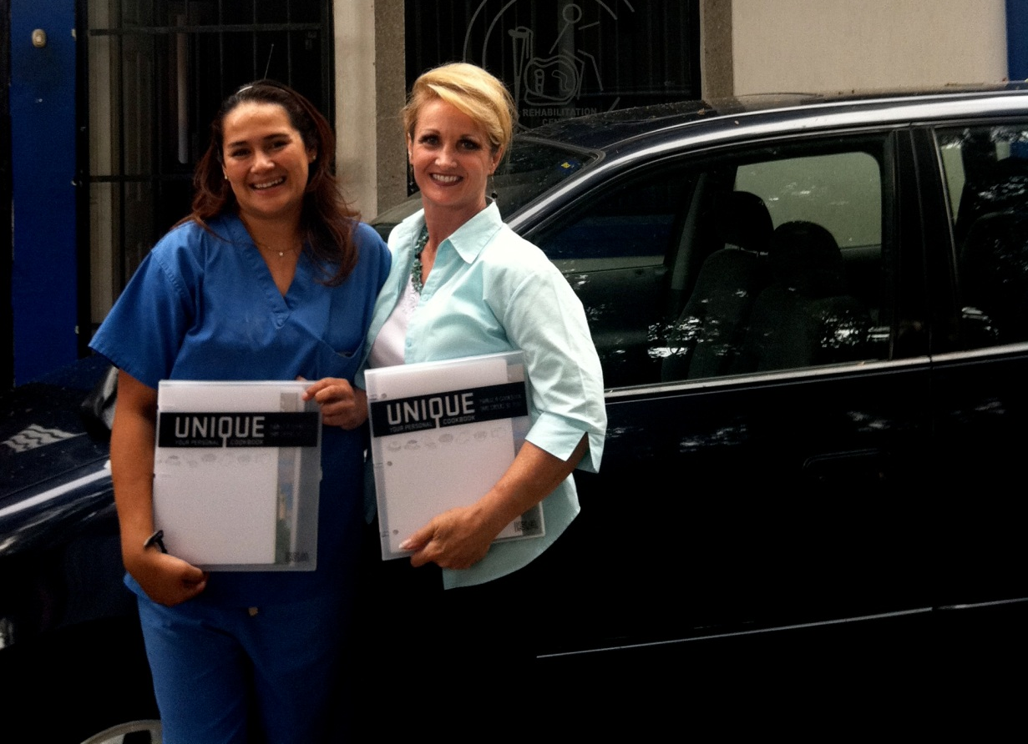
The Basic Need
Notes:
The economic crisis over the past several years has caused a reduction in social or charitable organizations ability to find funding in traditional ways. And so finding new sources of funding becomes the main component for organization sustainability (Balog, 2011).
for ISA fulfilling its mission and goals, depends on its ability to successfully raise funds. ISA has several fundraising activities that it produces throughout the year, but these fundraising projects have a finite ability to raise funds for the club.
The goal is to find projects that will enable the club to have continuous fundraising and increase success. <click>
Solutions & Approaches
Here are some of the sales, grants and gift opportunities that ISA currently has in its fundraising portfolio:
Family Fun Night
UVU Club Funding
Local Community Rotary Clubs
Orem Chamber of commerce
Concert - An Evening with Alex Boyé
Theater production-The Atonement
Campus Pizza Hut, Costa Vida and Jamba Juice Discount Cards
Grant for Engaged Learning
Annual Banquet & Silent Auction
Unique Cookbook
(J. Bagley, personal communication, August 1, 2012).
Recently the club has incorporated the ability to collect donations online through its website, creating an easier source of continuous donations (WeLovetheCause.com, 2012). This should increase the clubs ability to extend its reach and create some additional funding. <click>
The Director, Julie Bagley, is also actively searching for an Angel benefactor and has recently applied for additional large grant funding opportunities, but has been told that the need is too great for some of the small foundation grants that have been applied for.
The main topic of discussion here is how to increase funds received from the Unique Cookbook.
There are many ways that ISA can increase the fundraising possibilities of its Unique Cookbook. One possibility would be to raise the price from $20.00 to $25.00. This change has the potential to bring in an additional $2,500 per year.
Another option would be to move beyond the campus bookstore and sell it at local bookstores or at an online retailer like Amazon.com. Unfortunately, this option would add an additional fee to the cost of the book for the ability to sell the books in the stores and through Amazon.
There is another opportunity for the club to generate continuous funds and that is to move its Unique Cookbook to a digital online subscription format. This possibility will be the focus for this strategic plan. <click>
References
Balog, A. (2011). Applying social marketing in fundraising activities to civil society organizations. International Journal of Management Cases, 13(3), 416-430.
WeLoveTheCause.com (2012). Donate. Retrieved from: http://welovethecause.com/donate.php
Please Give (2012) Retrieved from: http://office.microsoft.com/en-us/images/results.aspx?qu=charity&ex=1#ai:MP910221024|
Solomon, R. (2012). ISA Fundraising chart [excel chart].
Unique Cookbook with Julie [photo].(2012). Retrieved August 28, 2012 from from J. Bagley, personal communication [email]
.

Slide 3
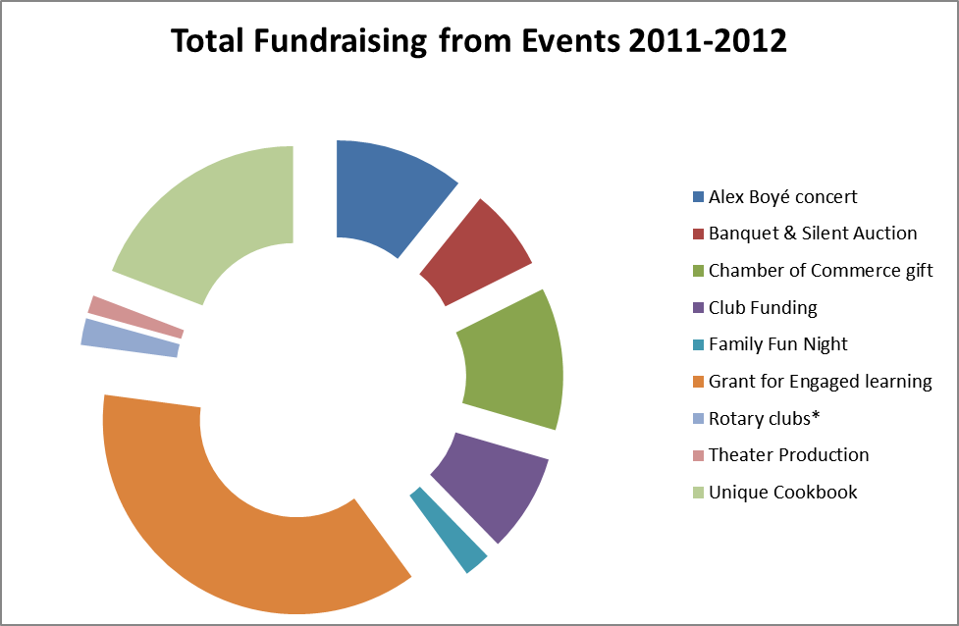
The Heart of the Plan
Notes:
The ISA’s Unique Cookbook currently supports <click>
19% of the club’s budget <click>
and 29% of revenues generated from the cookbook going to costs.
I believe that we can reduce the overall cost of the cookbook to almost zero <click>
by moving it to an digital subscription format that includes a mobile site and mobile App.
This has the possibility to increase the market reach from local to national and even global recognition.
It will allow subscribers to have access to new recipes without having to purchase and store another cookbook.
It will also give access to favorite recipes from just about anywhere without the book in hand.
The digital format should be easy to implement with the right people involved. UVU has a large organizational structure with many departments and tools that will help make this project to be successful. <click>
References
Solomon, R. (2012, a). ISA Fundraising chart [excel chart].
Solomon, R. (2012, b). Unique Cookbook Revenues chart [excel chart].
Girl at Computer (2012) Retrieved from: http://office.microsoft.com/en-us/images/results.aspx?qu=online&ex=1#ai:MP900433125|

Slide 4
Strategy
Solutions & Approaches
Advertise
here
Marketing Strategy
Who & What
Notes:
Solutions & Approaches to the Improve the Delivery of the Cookbook
There are several possible approaches for this project. One would be for the cookbook to go to a strictly digital subscription format. This format would include a flat fee for the cookbook with access for one year and a reduced fee for subsequent years. Each year would include new recipes and tips.
Another approach would be an online subscription with continued access to current recipes for one fee or donation. Subsequent years would have new recipes and tools but to gain access to these it would require a new donation.
Yet another approach would be to produce a few hard copies of the cookbooks and digital subscription format. Each year would require a new subscription for new content and continued access to the previous edition. If the subscriber decided not to renew the subscription, they would still have access to the content available with their initial subscription, not any of the new content. <click>
Strategy
Our strategy will use a combination of approaches.
This will allow for a transition period between the printed version and the digital version.
This is best because there are already buyers of the printed version.
This will better enable ISA to promote the upcoming digital version.
Producing a few hard copies gives buyers the option of going digital or having a hard copy, and allows for an easy transition for customers who may not be comfortable with technology.
The hard copy will include a trial version of the digital copy to familiarize customers with the digital version for when the cookbook is only available in digital format. <click>
Marketing
Marketing is a driving factor in what makes ISA successful. After the cubs 2011 trip, the best marketing campaign that the club had were the spots on several of the local television news programs. These spots lead to interest in the program and helped to spread the word to possible new donors. ISA’s other marketing is more traditional direct contact, digital announcements at the university, its website, WeLoveTheCause.com, YouTube and handbills that create new and renewed interest in the program. The efforts at the school provide interested volunteers as well as new funds.
To promote the new format of the cookbook ISA will use all of the avenues mentioned previously along with an email campaign to past supporters in an effort to gain interest in the cause and highlight the good that the subscription will do to support the cause.
The idea of the digital format is to increase funds available for use for the expeditions and the good it will provide those that receive the prosthetic and will be one of the main marketing points.
Other marketing points are:
The ability of the users to create their own cache of favorite recipes, and to create and store their own recipes.
The mobile App will enable users to take their favorite recipes with them wherever they are; no need to print the recipe to take it into the kitchen, making the digital format environmentally friendly as well as convenient.
Lastly, the ISA club is a 501c3 nonprofit (J. Bagley, personal communication, August 10, 2012) so the purchase of the subscription would be nonprofit donation and tax deductible.
The market segment for the digital cookbook is a niche market. The main subscribers would be
Previous customers
Supporters of the cause that like to cook
Supporters of the cause <click>
Now we are going to look at
Who and What
The ISA Club and its Director, Julie Bagley
The club and its director will be responsible for working with the project manager to develop the requirement of work (ROW) project map. This document will be used by the web development team in its development of the online format of the Unique Cookbook.
The Project Manager, Rachael Solomon
It will be the responsibility of the project manager to develop the strategic plan and outline the project timeline. The project manager will also partner with the web development team and the ISA club to ensure that the product developed meets the specification of the ROW and to revisit it with both teams to make sure that it still fits the needs of the project.
UVU Web Development
It will be the responsibility of the UVU Web Development department to develop the internet platform for the cookbook subscription. They will work with the project manager and the ISA club to determine the needs and wants of the club for this project. They will follow the ROW as outlined and work with the rest of the team if the ROW needs to be revisited and updated. <click>
References
Success (2012). Retrieved August 28, 2012 from: http://office.microsoft.com/en-us/images/results.aspx?qu=success&ex=1#ai:MP910220933|
Chess (2012). Retrieved August 28, 2012 from: http://office.microsoft.com/en-us/images/results.aspx?qu=chess&ex=1#ai:MP900426465|
Billboard (2012). Retrieved August 28, 2012 from: http://office.microsoft.com/en-us/images/results.aspx?qu=billboard&ex=1#ai:MP900442493|
Thumbs-up People (2012). Retrieved August 28, 2012 from: http://office.microsoft.com/en-us/images/results.aspx?qu=team&ex=1#ai:MP900443014|

Slide 5
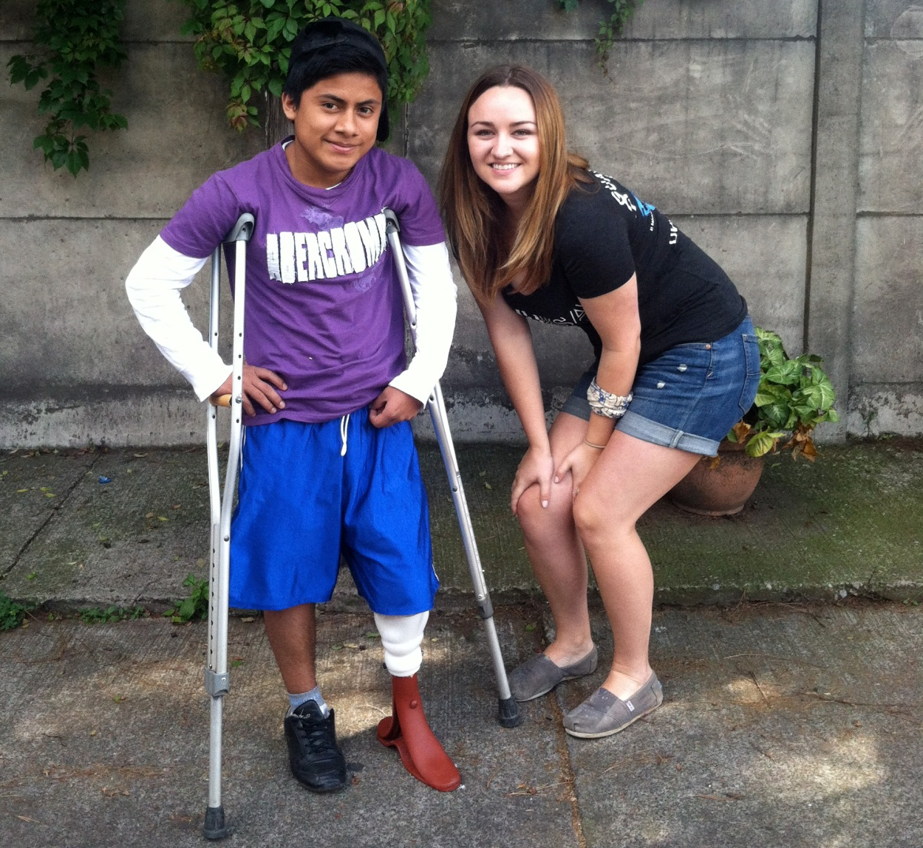
Questions?
Thank you
Notes:
As a University club, ISA has a responsibility to include the core values of the University in its own values, which it does as it carries out its mission. ISA’s core mission and values build out of the University’s mission to be engaged and create global minded professionals. This plan will help to facilitate the mission for creating global mined professionals by generating funds that will enable the ISA to continue its mission to provide prosthetics to amputees in underdeveloped and developing nations. Thank you for listening. <click>
Are there any questions?
References
Student and Prosthetic Recipient [photo].(2012). Retrieved August 28, 2012 from from J. Bagley, personal communication [email]

